Slide 1
Style transformation with Convolutional Neural Network
Yu Shun Lin, Sicheng Ke, Tianchu Li

Slide 2
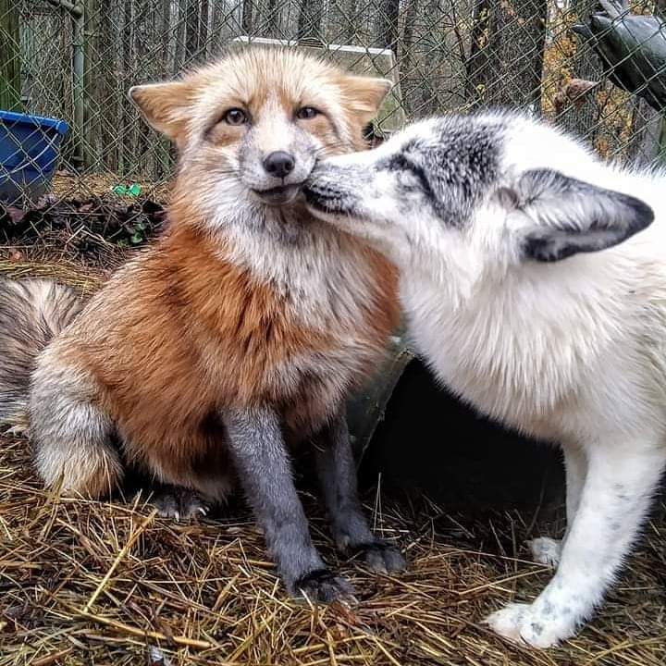
Concept
Style loss
Style target
Loss function network
Image transformation network
output
content
Input image
Feature loss
We need to find the minimum of total loss
Notes:
Network structure is CNN

Slide 3
VGG19
VGG19 is a pre-trained network weight with over 1 million pictures for recognition of objects.
The Keras deep learning Classifier which classify image to Cat, Dog, Train, etc
We need this to detect the object feature for image transformation
Also vgg19 pre-trained network also be used to minimize the perceptron loss function

Slide 4
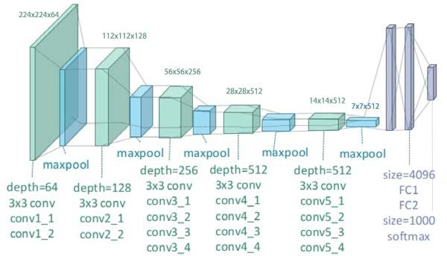
VGG19
Feature learning and classification in VGG19
Notes:
47 layers with polling max in every layer, output activation function = softmax

Slide 5


Loss function and concept of transformation
Loss function is designed for minimizing the difference of input image and output image
Loss = Style Weight * Style Loss + Content Weight * Content Loss
Weight from image transform network Feature reconstruction loss
Notes:
Feature reconstruction loss CHW is the feature map of shape
Losing network difference be squared and normalized
J is the j’s layer in network y across is the target

Slide 6
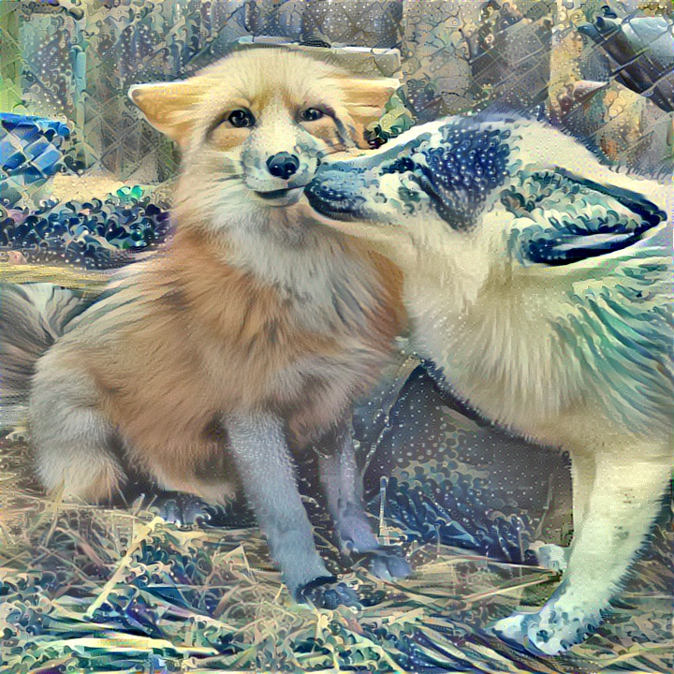
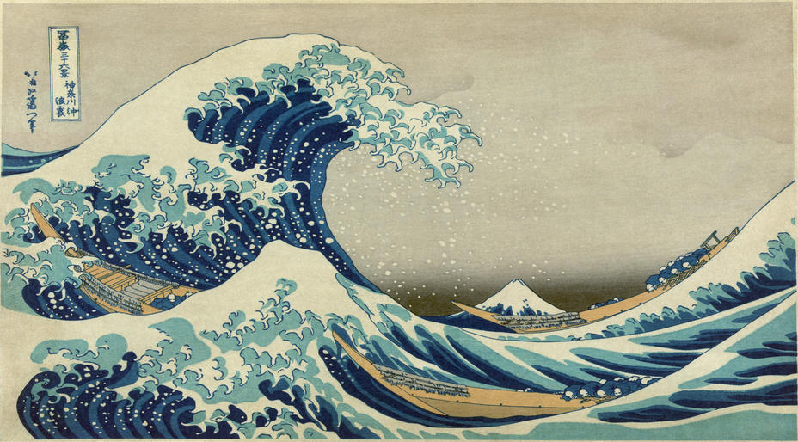
Transformation example
The transfer is based on 1000 iteration
We take this image because some detail feature did not transfer obviously

Slide 7
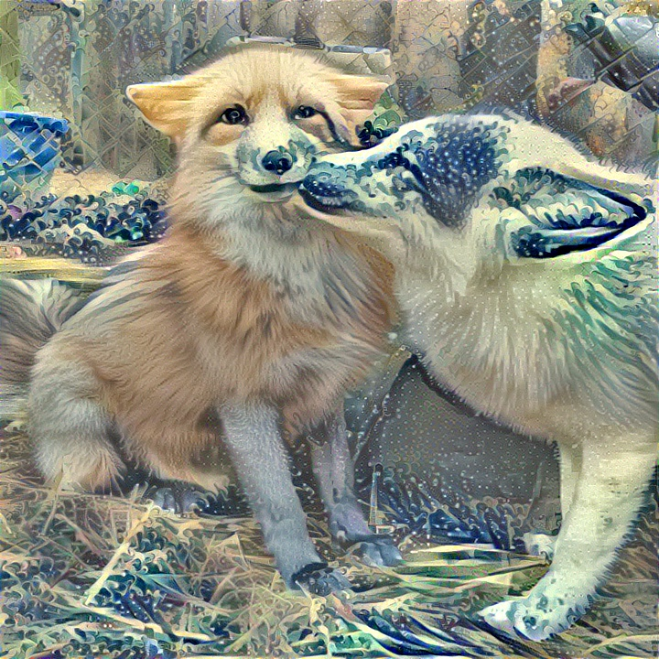
Relu & Sigmoid
Relu
Sigmoid

Slide 8
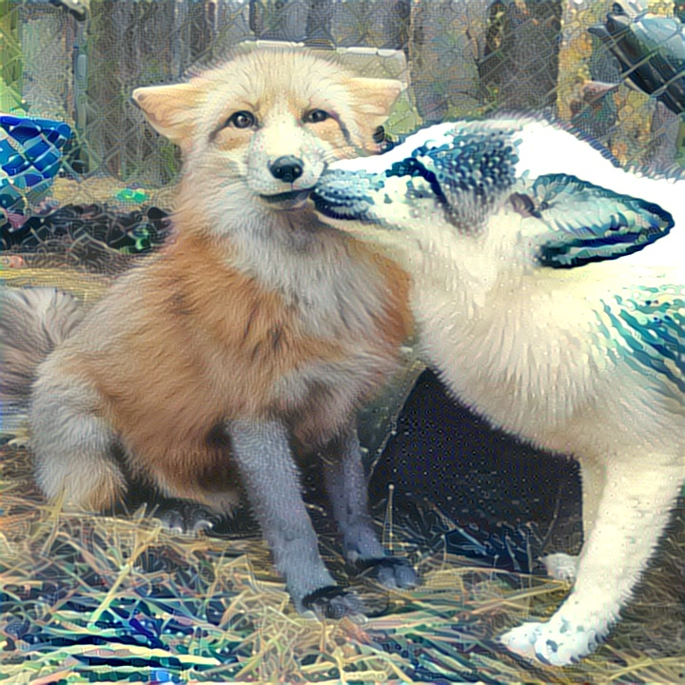
Average pooling and max pooling
Average pooling Max pooling

Slide 9
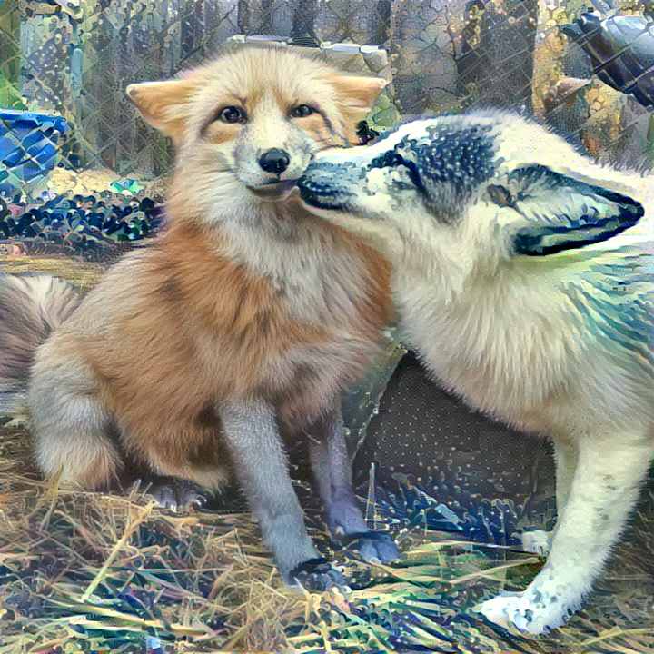
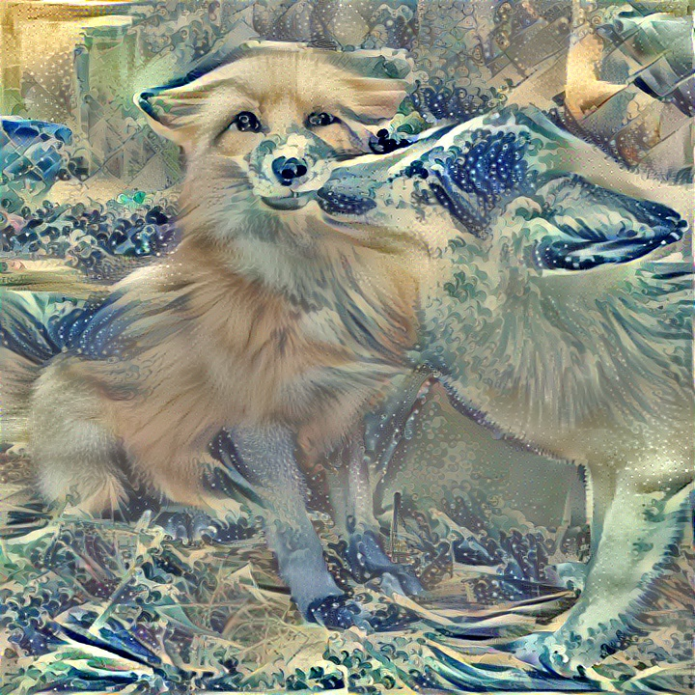
Different style weights
Style image
Style weight=100
Style weight=2000

Slide 10
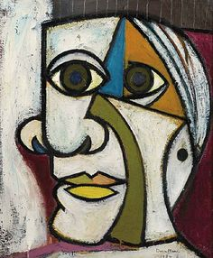
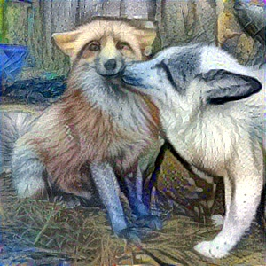
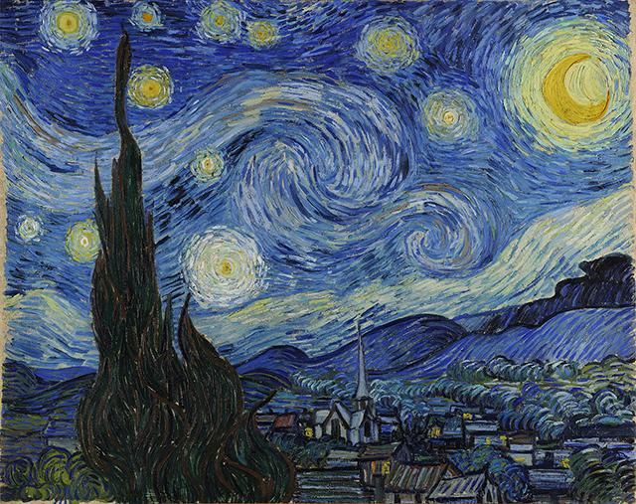
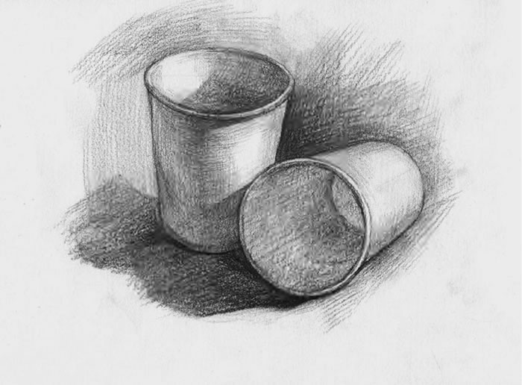
Trying different mixture style to same image
The new style image is the combination of three style images

Slide 11
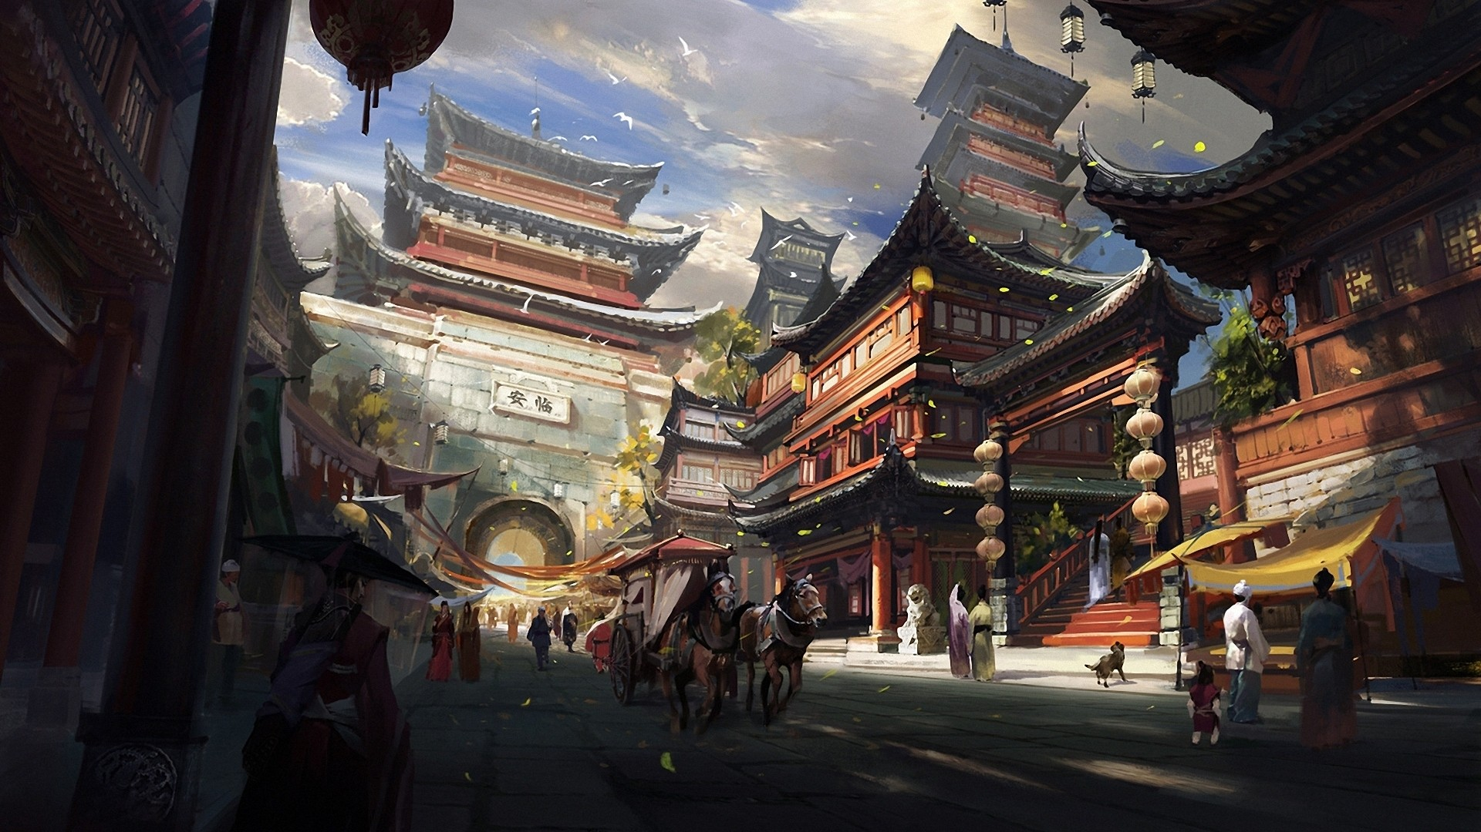
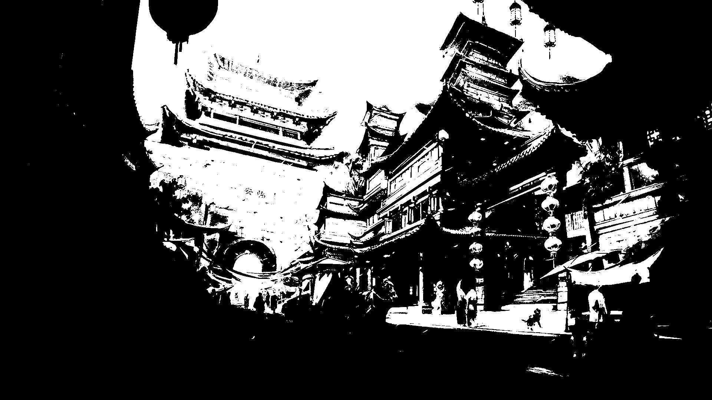
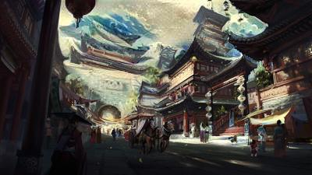
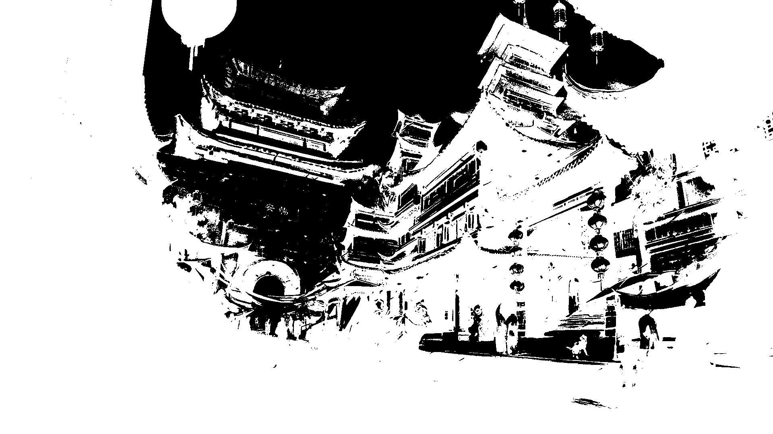
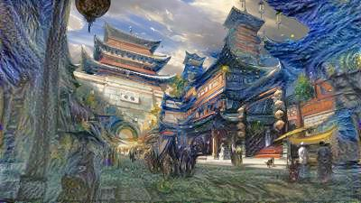
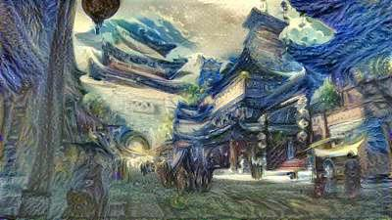
Mixture with image mask
We also try another way to mixture the style of image. Implement semantic segmentation to create mask of the image.

Slide 12
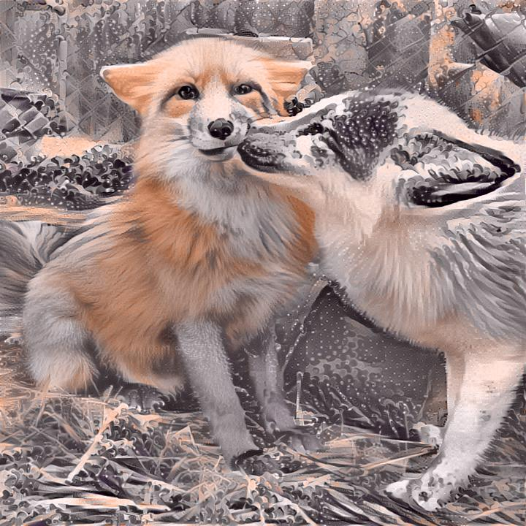
Color preservation

Slide 13
Future works
Details transformation
Segment Image by kind of object through objects recognition by CNN
Adding random style learned from feature neural network (creative drawing)
Object guess of sketch (guess the object complete the pattern and coloring )
Train not only for features detecting but also for features creating.

Slide 14
Q & A

